Slide 1


PSAwtrix3 Powershell goes Matrix
Frank Lindenblatt
@Flittermelint

Slide 2






Thanks to our sponsors:
#PSSATKA

Slide 3
Agenda
Whoami & Credits
Topic ⮚ Hardware & Module
Apps ⮚ Built in & Custom😎
Notifications
Filesystem
Miscellaneous
Builtin WebServer
Device Discovery
#PSSATKA

Slide 4

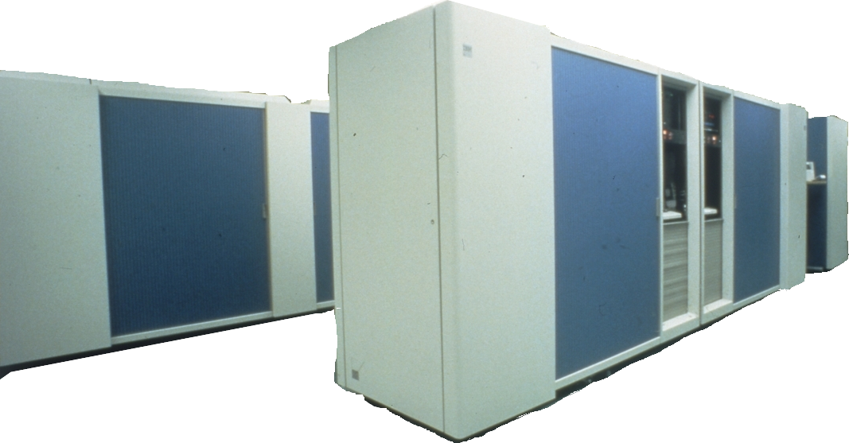


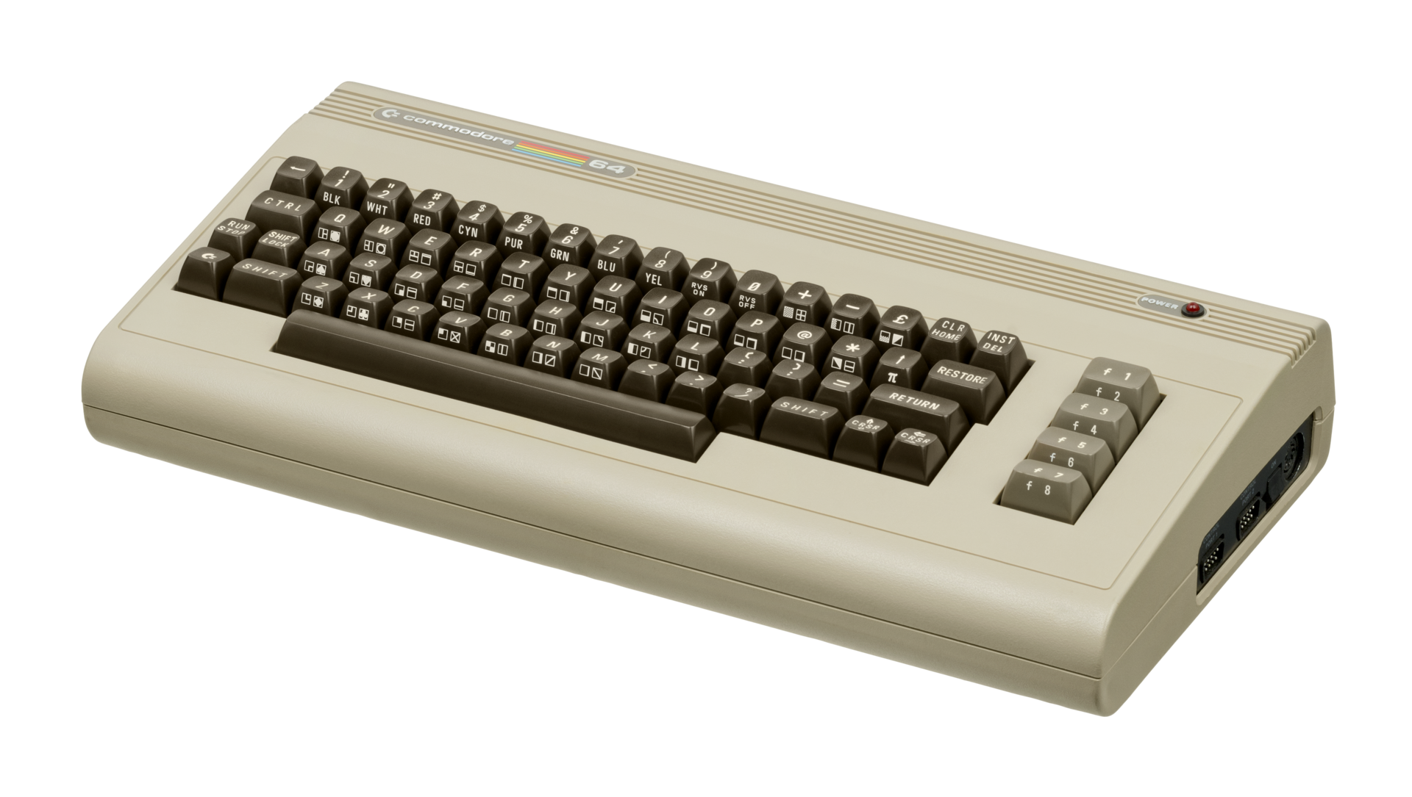
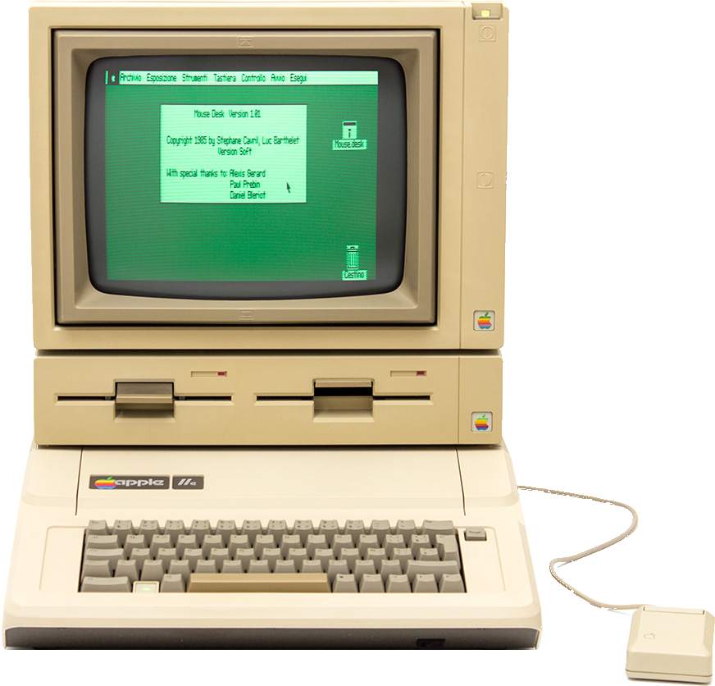
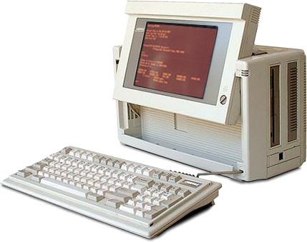

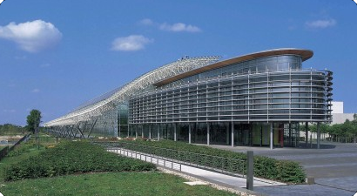
Whoami
Name : Frank Lindenblatt
IT since : 1984 💶1988
My role : Senior DevOps-Engineer
Employer : Finanz Informatik
eMail : flittermelint@web.de
X & Github: @Flittermelint
IT passion: Powershell outside the mainstream, Mixed language coding
#PSSATKA

Slide 5





Credits
@Blueforcer
@Gerrit-KMeier
https://github.com/Blueforcer/awtrix3
https://github.com/Gerrit-KMeier
https://discord.gg/cyBCpdx
My family
#PSSATKA

Slide 6


Topic ⮚ Ulanzi TC001 Smart Pixel Clock
https://www.ulanzi.com/products/ulanzi-pixel-smart-clock-2882
#PSSATKA

Slide 7

Topic ⮚ PSAwtrix3
https://github.com/Flittermelint/PSAwtrix3
⮚ Actually 62 functions and not even close to feature complete…
#PSSATKA

Slide 8




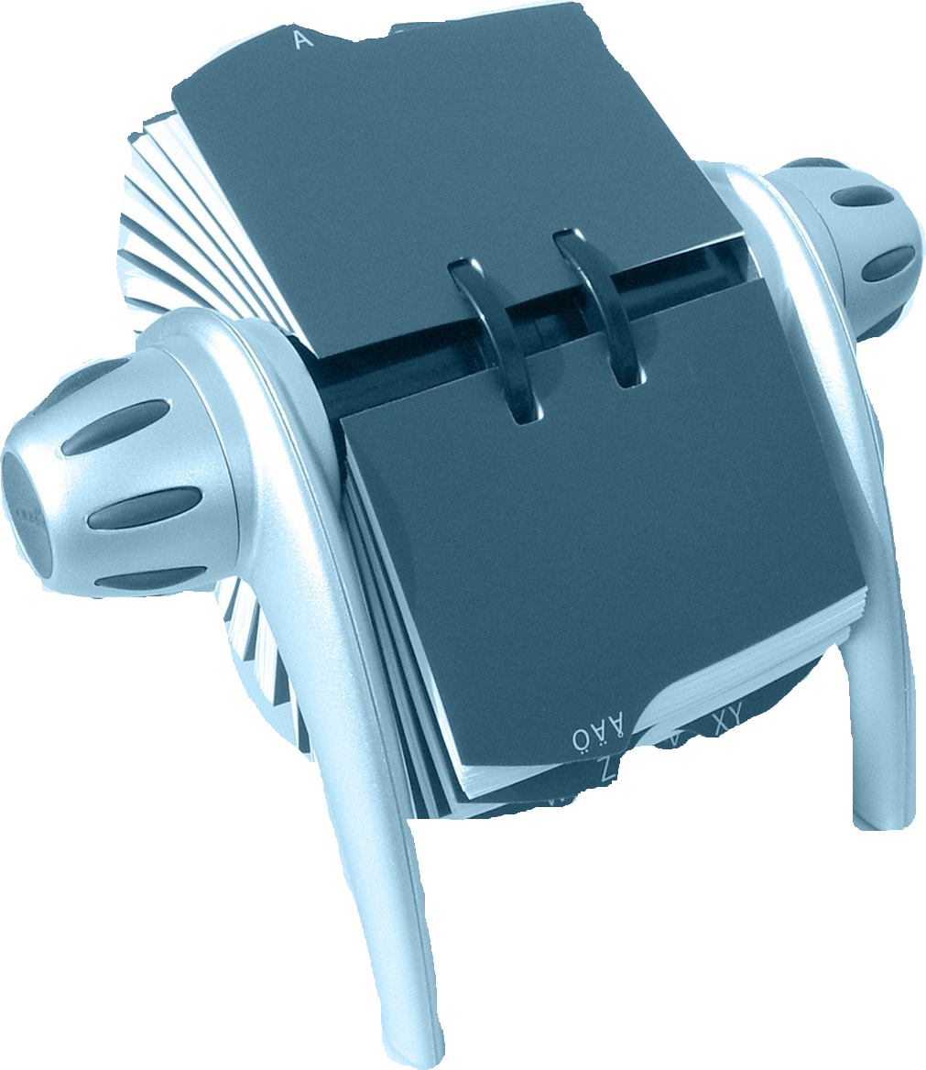

Apps ⮚ Built in
⇩
Time
⇦ Switch-Awtrix –App Time
⇩
Date
⇦ Switch-Awtrix –App Date
⇩
Temperature
⮚
Comparable
to a Rolodex
⇩
⇩ … –Next
Humidity
⇩
⇧ … -Prev
Battery
⇩
⮚ AppLoop
#PSSATKA

Slide 9
Apps ⮚ Built in
Disable-Awtrix –App Temperature ⇨
Enable-Awtrix –App Battery ⇨
#PSSATKA

Slide 10
Apps ⮚ Custom
Not comparable to smartphone apps
No logic (doesn’t contain code)
Can’t be “installed” on the device
⮚ Well, but what ARE CustomApps?
#PSSATKA

Slide 11
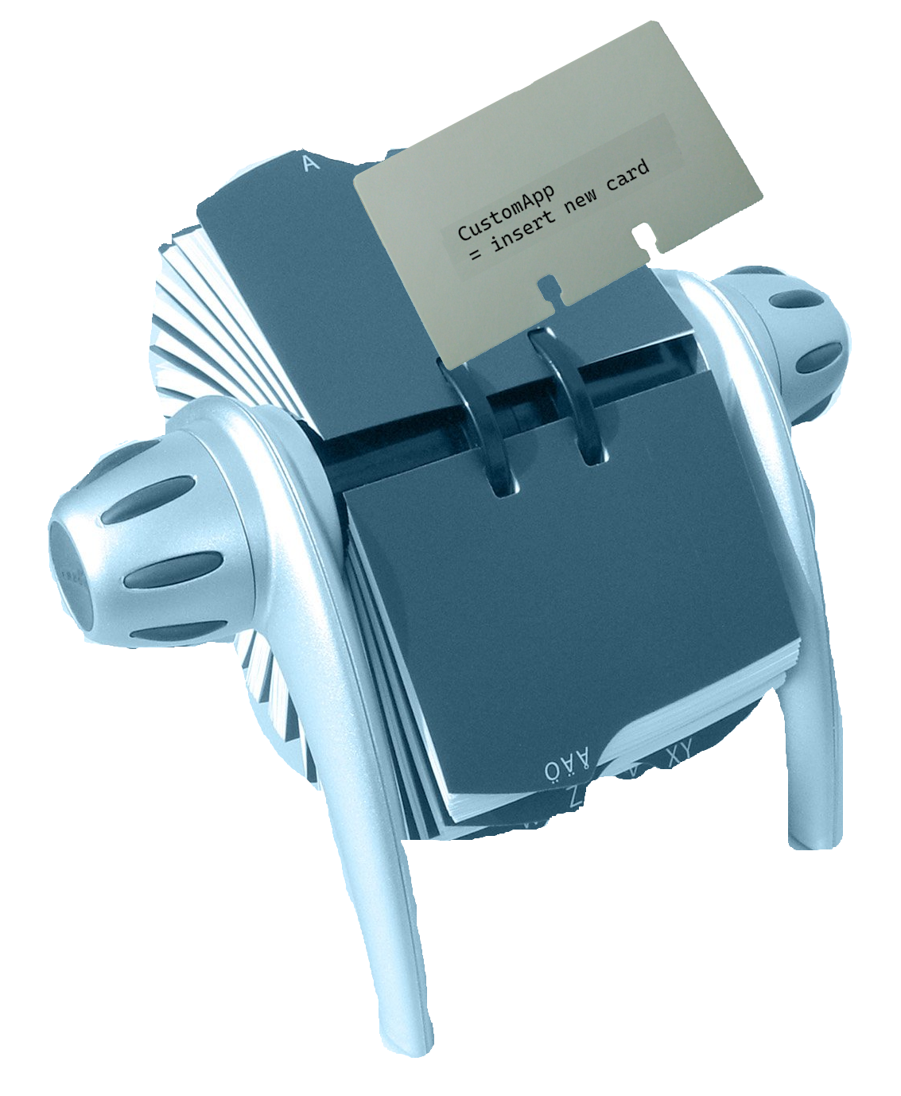
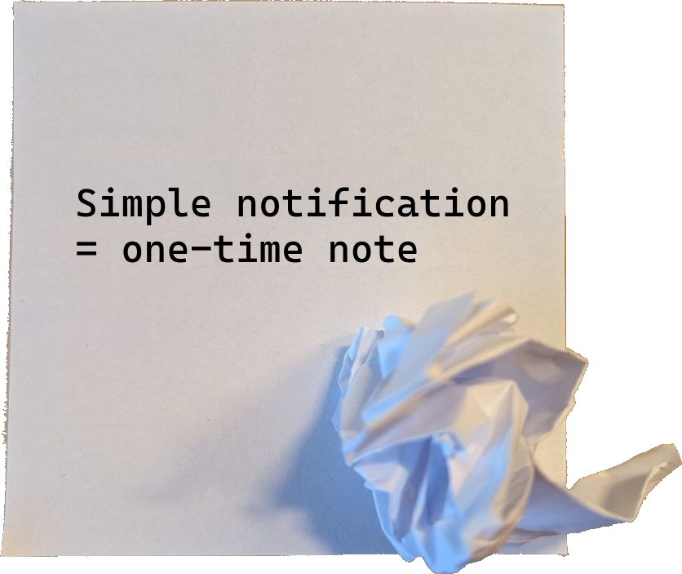
Apps ⮚ Custom
• updatable text messages and/or images
⮚ updating let them behave like “apps” or maybe better spoken like “dynamic pages”
⮚ will automatically be removed if not being updated within a specified timespan
⮚ or will become [stale] if not being updated within a specified timespan
• displayed repeatedly during the “AppLoop”
⮚ THE difference to a “simple” notification, which behaves like a crumpled note, in comparison to a Rolodex
⮚ Okay, so how can we create CustomApps?
vs
#PSSATKA

Slide 12

Apps ⮚ Custom
It’s quite simple to create CustomApps…
> Write-Awtrix -Icon xmas_tree_blink -Text "PSSatKa" -Rainbow -CustomApp "PSSatKa"
#PSSATKA
Notes:
We’ll treat the Write-Awtrix cmdlet later under the agenda point “Output”
@The End: Is this christmassy enough? Probably not…

Slide 13




Notifications ⮚ Samples
> Write-Awtrix -Text "#PSSATKA" -Rainbow
> Write-Awtrix -Icon "8x8/Alert2" -Text "On Air" -Background Red
> Write-Awtrix -Icon 32x8/PSAwtrix.Movie
> Write-Awtrix -Draw @(
Circle 28,4 3 red -Fill
Rectangle 20,4 4,4 Blue -Fill
Text 0,0 "Hello" Lime
Pixel 31,0 -Color Aqua
Line 0,7,18,7 Yellow
)
> Out-Awtrix -Text Awtrix -Melody "ATeam" # Play “ATeam” theme
#PSSATKA

Slide 14
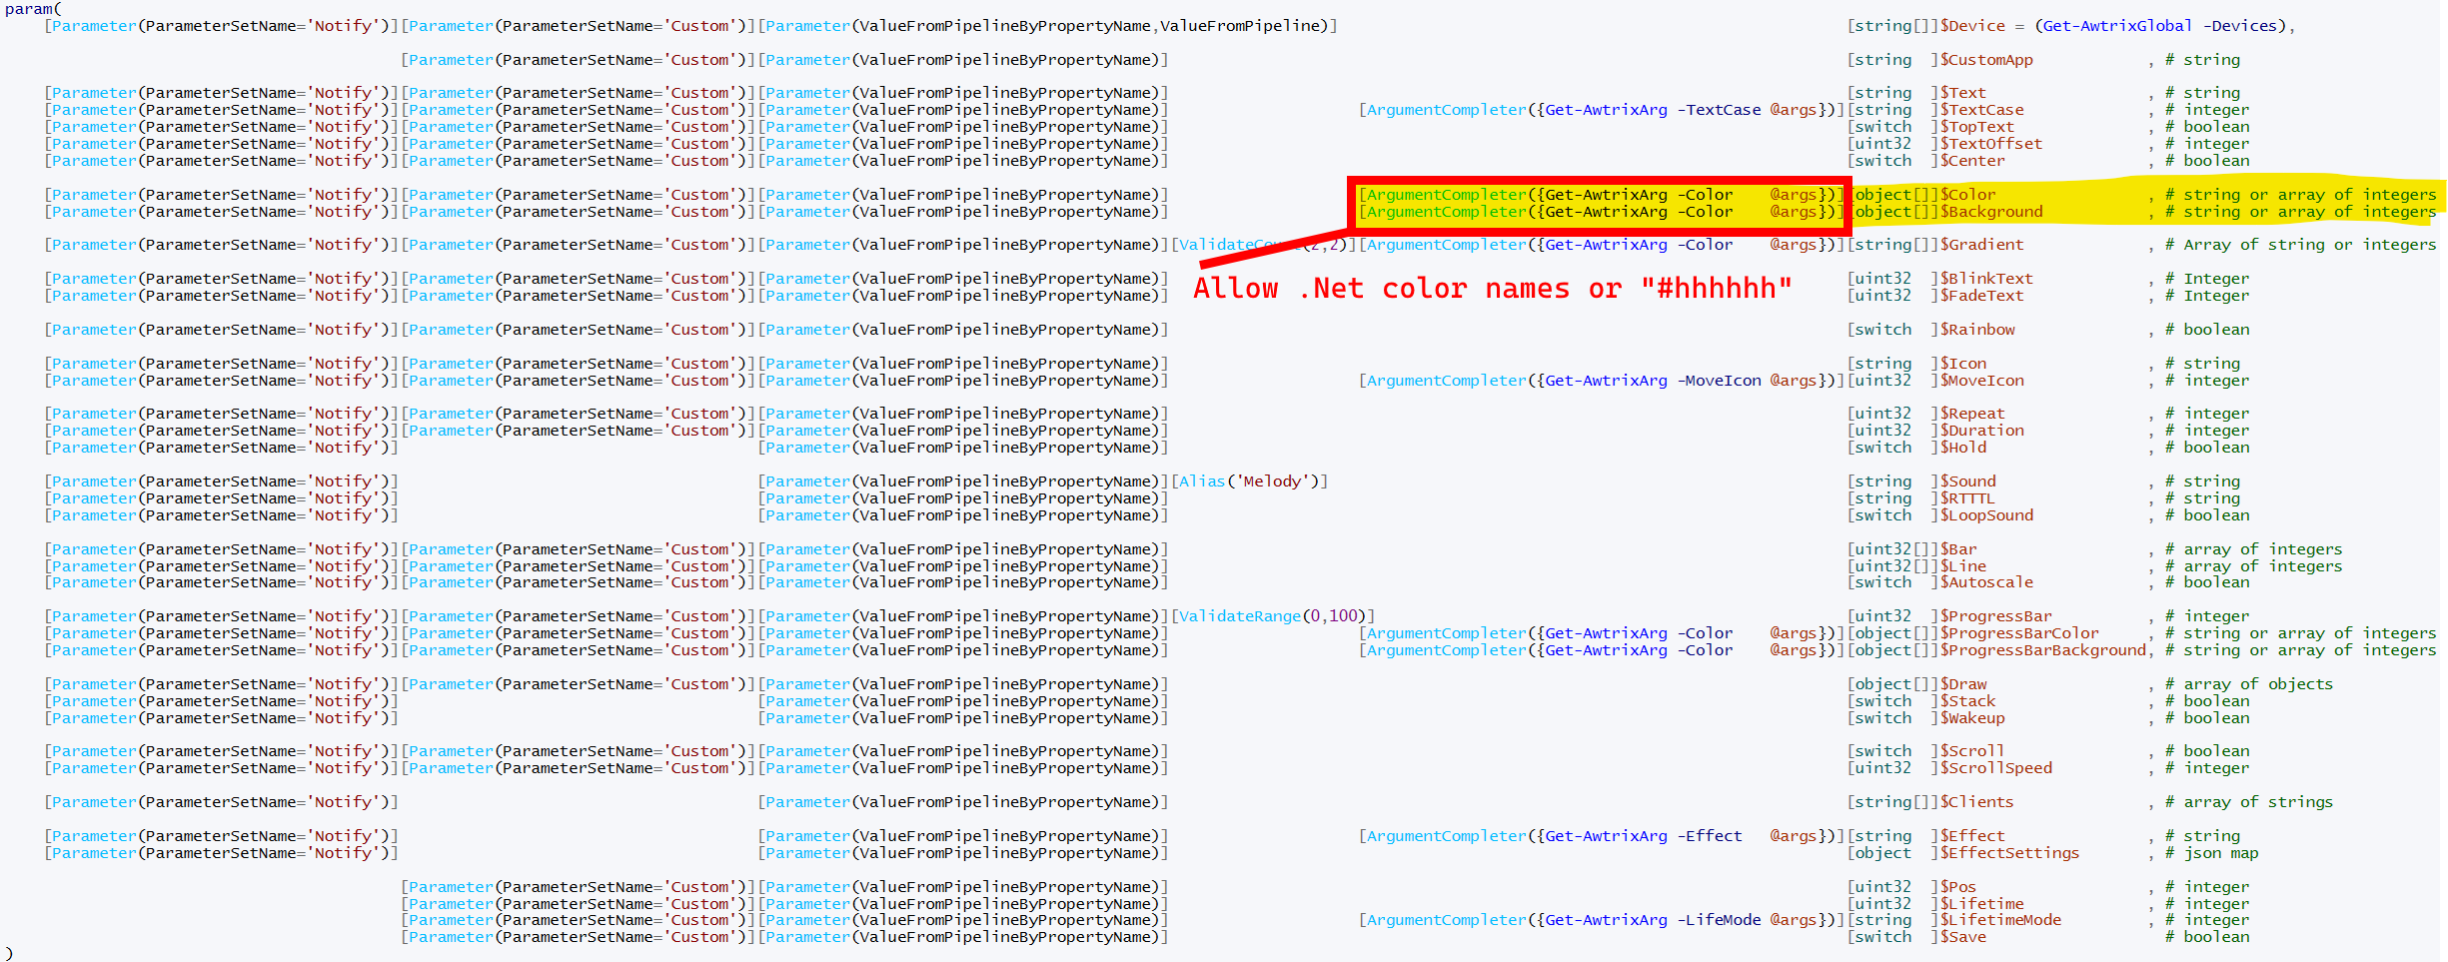
Notifications ⮚ Parameters
#PSSATKA

Slide 15
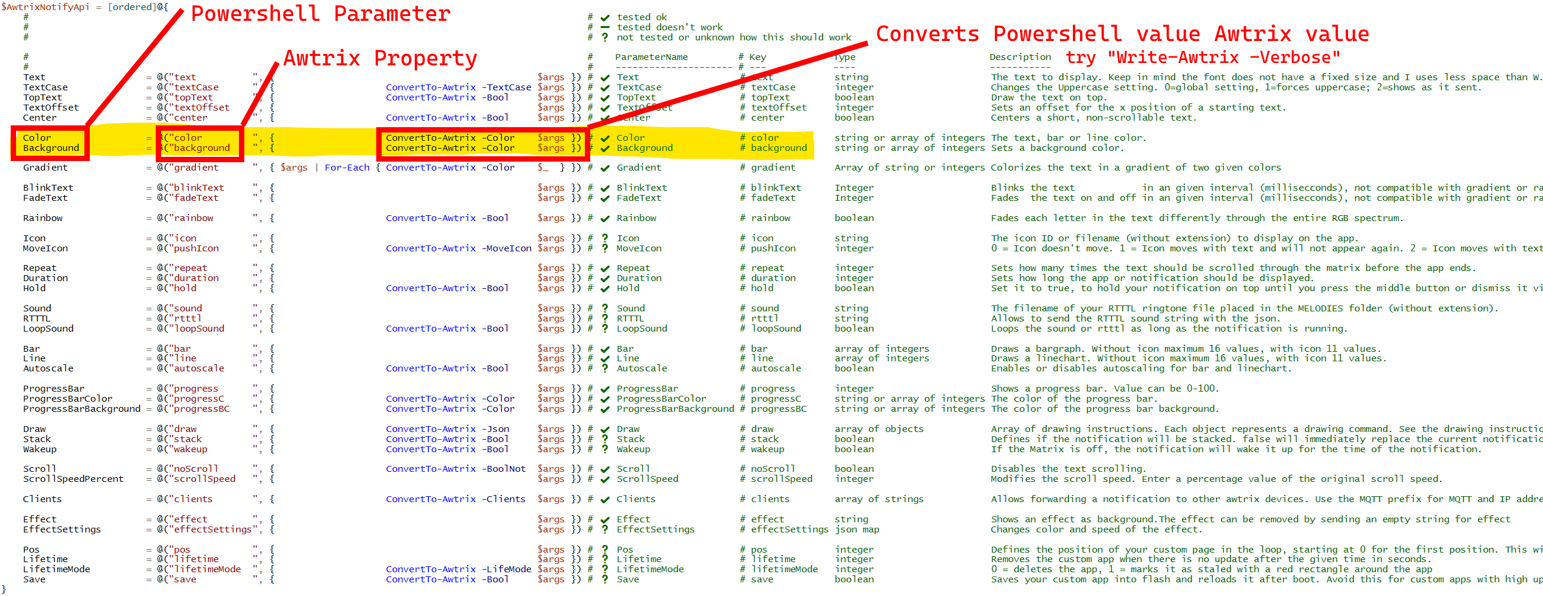
Notifications ⮚ Converters
#PSSATKA

Slide 16
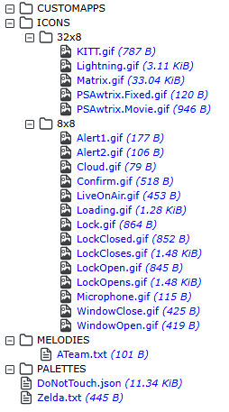
Filesystem
type size name
dir 0 /ICONS
dir 0 /ICONS/32x8
file 120 /ICONS/32x8/PSAwtrix.Fixed.gif
file 946 /ICONS/32x8/PSAwtrix.Movie.gif
dir 0 /ICONS/8x8
file 177 /ICONS/8x8/Alert1.gif
dir 0 /MELODIES
file 101 /MELODIES/ATeam.txt
dir 0 /PALETTES
file 11609 /DoNotTouch.json
> Get-AwtrixChildItem -Path "/" -Recurse | ForEach-Object Values
____ ____ ____
😴 My dream: wrap filesystem into
an “Awtrix:” provider
#PSSATKA
Notes:
As indicated earlier there’s a built in explorer alike webpage, where we can manage the files, stored on device
But we’re Powershellistas, so we want to explore the filesystem by Powershell and that’s quite easy

Slide 17





Miscellaneous
> Restart-Awtrix # speaks for itself
> Disable-Awtrix -Display
⇨
> Enable-Awtrix -Display
⇨
> Enable-Awtrix -Indicator UpperRight -Color Green
> Enable-Awtrix -Indicator RightSide -Color Orange
> Enable-Awtrix -Indicator LowerRight -Color Red
> Disable-Awtrix -Indicator *
#PSSATKA

Slide 18
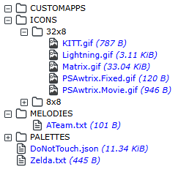
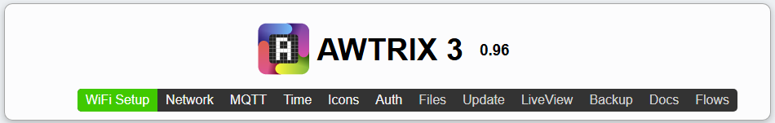

Builtin WebServer
> Show-AwtrixWebPage #
> Show-Awtrix –Files # the device online file “explorer”
> Show-Awtrix –Update # show the device update firmware page
> Show-Awtrix –LiveView # look at the display if you’re miles away
> Show-Awtrix –Fullscreen # similar to “liveview” but “fullscreen”
#PSSATKA

Slide 19
Device Discovery
> $awtrix = Get-AwtrixNetwork “Your WiFi SSID” | Find-Awtrix
Name Value
awtrix_116a58 192.168.0.101
awtrix_11da4c 192.168.0.100
____ _____
Name is built by “awtrix_” and
last 6 digits of MAC address
> ([ordered]@{
"awtrix-01" = $awtrix["awtrix_116a58"]
"awtrix-02" = $awtrix["awtrix_11da4c"]
}) | Register-AwtrixAlias -Global
⮚ Register “alias” names for convenient access
⮚ No need to rename device in your WiFi router
#PSSATKA

Slide 20

DEMO
#PSSATKA

Slide 21


Rate this session
Giving feedback is like wrapping a Christmas gift: thoughtful, personal, and meant to bring joy.
#PSSATKA

Slide 22

Thanks for your attention,
it was a pleasure
#PSSATKA

